Slide 1
HTTP, Website Architecture and Middleware

Slide 2
Overview of HTTP
Basically, HTTP is a TCP/IP based communication protocol, that is used to deliver data (HTML files, image files, query results, etc.) on the World Wide Web. The default port is TCP 80, but other ports can be used as well. It provides a standardized way for computers to communicate with each other. HTTP specification specifies how clients' request data will be constructed and sent to the server, and how the servers respond to these requests.
HTTP is connectionless:
HTTP is media independent:
HTTP is stateless

Slide 3
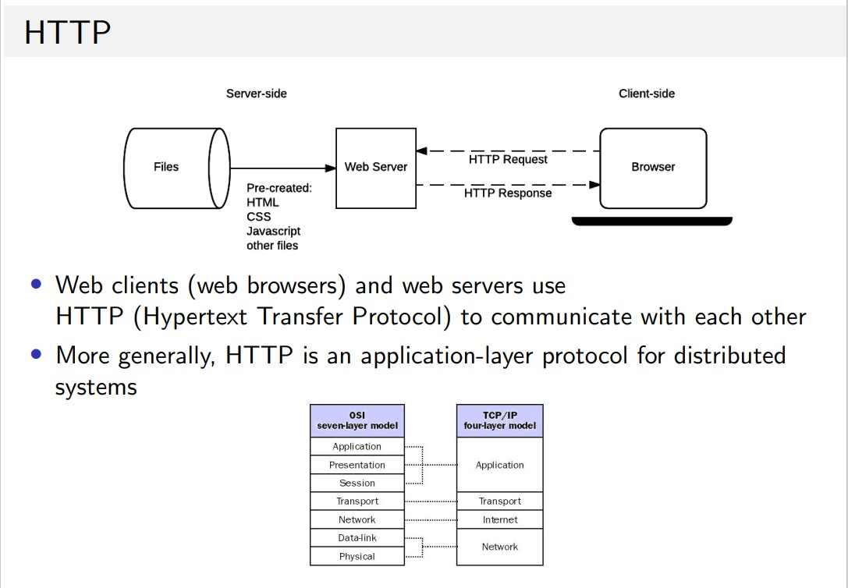
Overview of HTTP

Slide 4
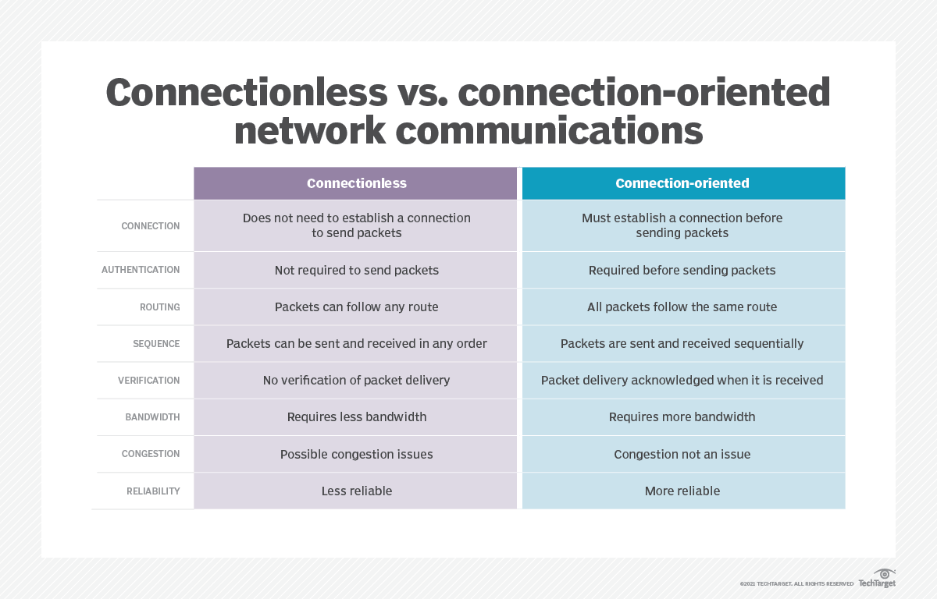
Overview of HTTP

Slide 5
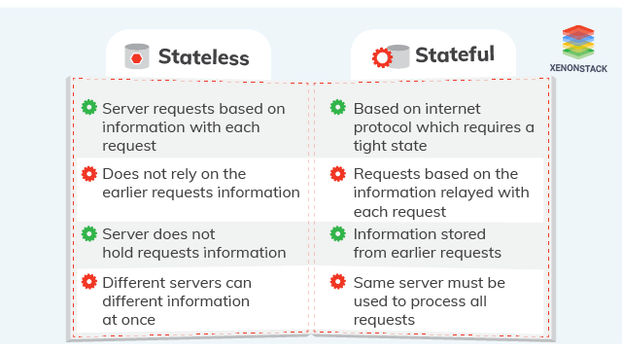
Overview of HTTP

Slide 6
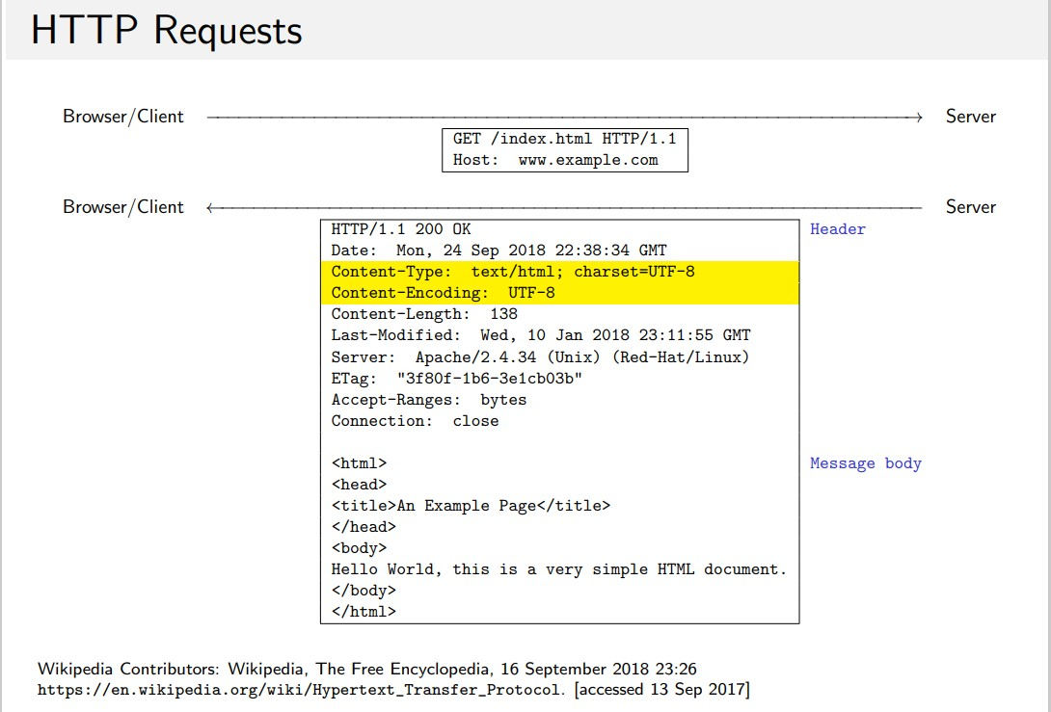
Overview of HTTP

Slide 7
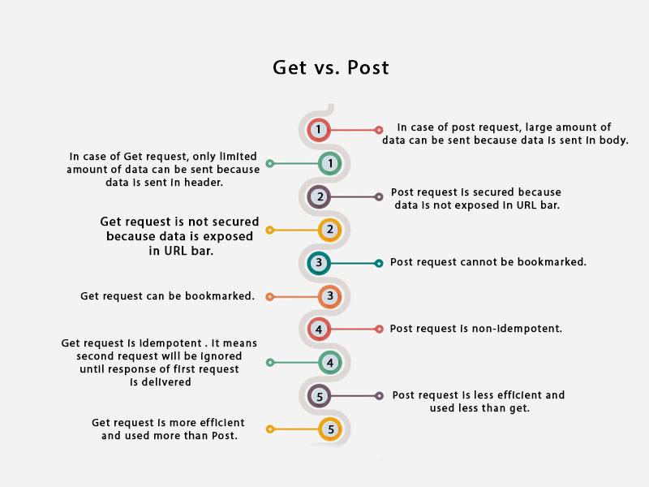
HTTP Get vs Post

Slide 8
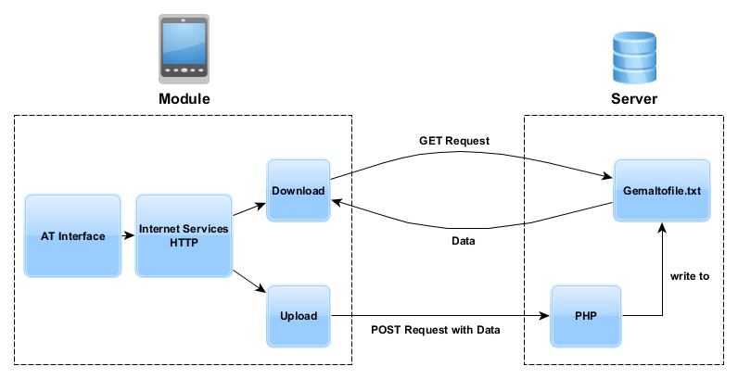
HTTP Get vs Post

Slide 9
Server-side Programming
Uses
Process user input.
Compiles pages.
Structure web applications.
Interact with permanent storage (SQL, files).
Example Languages
PHP
Python
ASP.Net in C#, C++, or Visual Basic.
Nearly any language (C++, C#, Java). These were not designed specifically for the task but are now often used for application-level web services.

Slide 10
Client-side Programming
Uses
Make interactive webpages.
Make stuff happen dynamically on the web page.
Interact with temporary storage, and local storage (Cookies, localStorage).
Send requests to the server and retrieve data from it.
Provide a remote service for client-side applications, such as software registration, content delivery, or remote multi-player gaming.
Example Languages
JavaScript (primarily)
HTML*
CSS*
Any language running on a client device that interacts with a remote service is a client-side language.

Slide 11
Simple vs. Multi-tiered
Web Site Architecture
System architecture
  Arrangement of software, hardware, and tasks in an information system needed to achieve a specific functionality.
Two-tier
  Web server and database server
Multi-tier
  Web application and other servers
  Backend, legacy databases

Slide 12
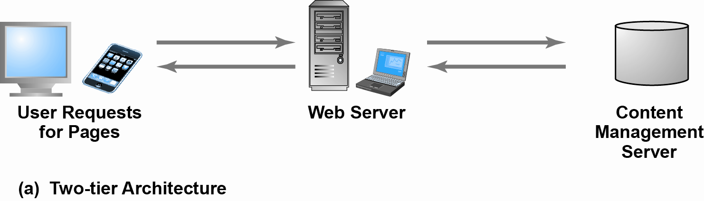
Two-Tier E-commerce Architecture
Figure 4.11(a), Page 207

Slide 13
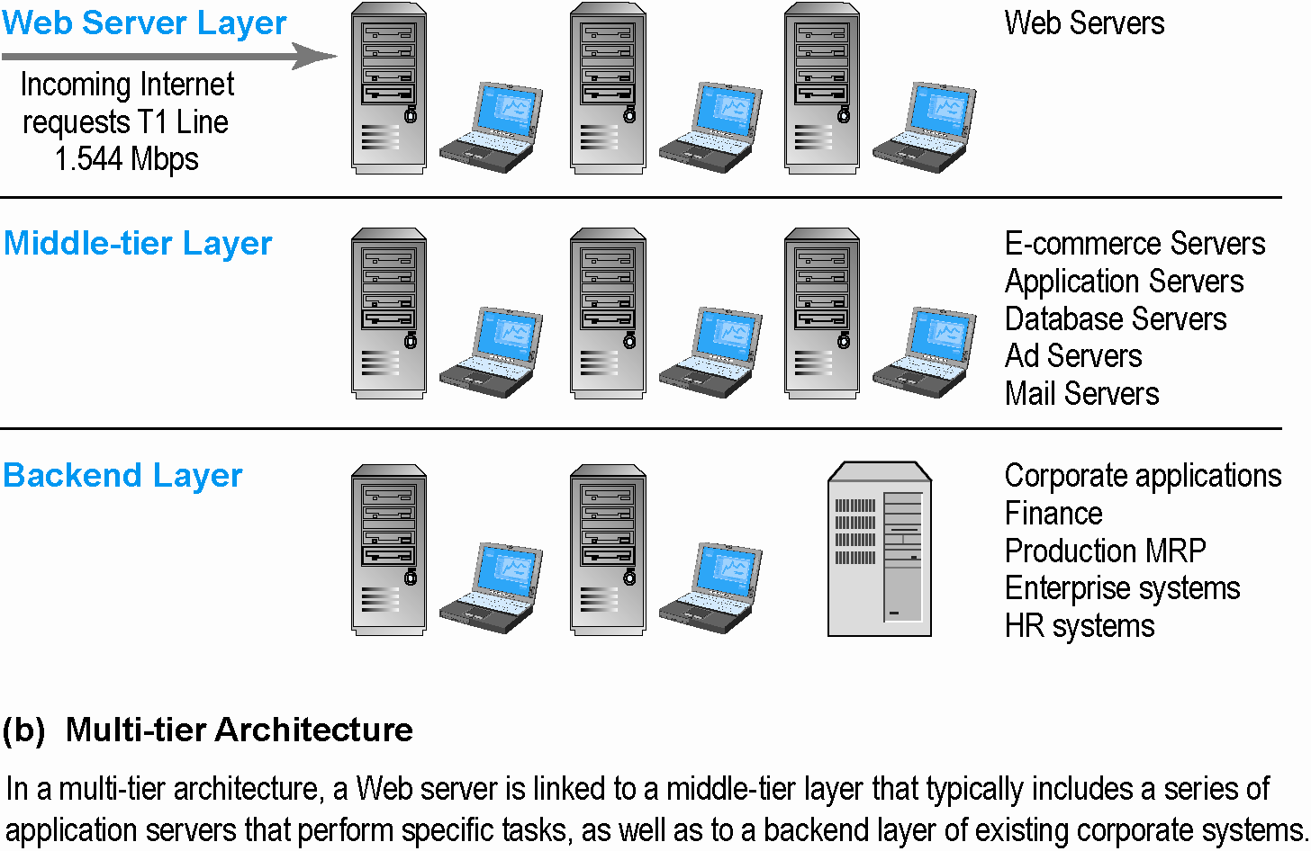
Multi-Tier E-commerce Architecture
Figure 4.11(b), Page 207

Slide 14
Web Server Software
Apache
  Leading Web server software (52% of market)
  Works with UNIX, Linux operating systems
  Comes loaded on IBM systems
Microsoft’s Internet Information Server (IIS)
  Second major Web server software (20% of market)
  Windows-based

Slide 15
Dynamic Page Generation Tools
Dynamic page generation:
  Page contents stored in database and fetched when needed
  Lowers menu cost
  Enables market segmentation
Common tools:
  Common Gateway Interface (CGI)
  Active server pages (ASP)
  Java Server Pages (JSP)
  Open Data Base Connectivity (ODBC), a std DB access method allows connections to any DB
Advantages
  Lowers menu costs
  Permits easy online market segmentation
  Enables cost-free price discrimination
  Enables content management system (CMS)

Slide 16
Application Servers
Web application servers:
  Is a server program in a computer in a distributed network that provides the business logic for an application program. Often viewed as a 3-tier application.
  It divides the application into
    1ST tier: front end – web browser GUI
    2nd middle tier: business logic
    3rd tier: back end – DB and transaction server

Slide 17
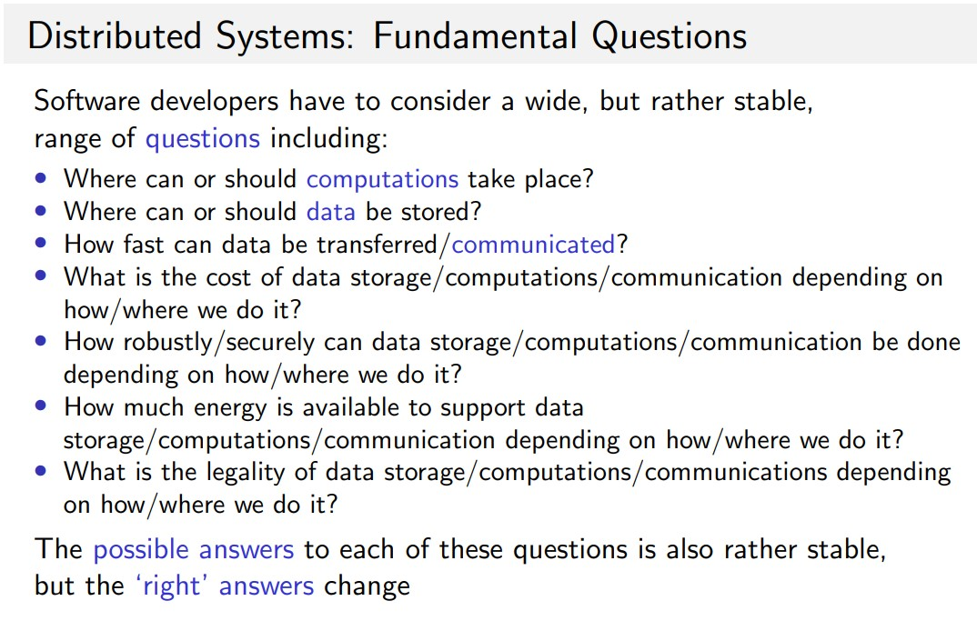
Distributed Systems

Slide 18
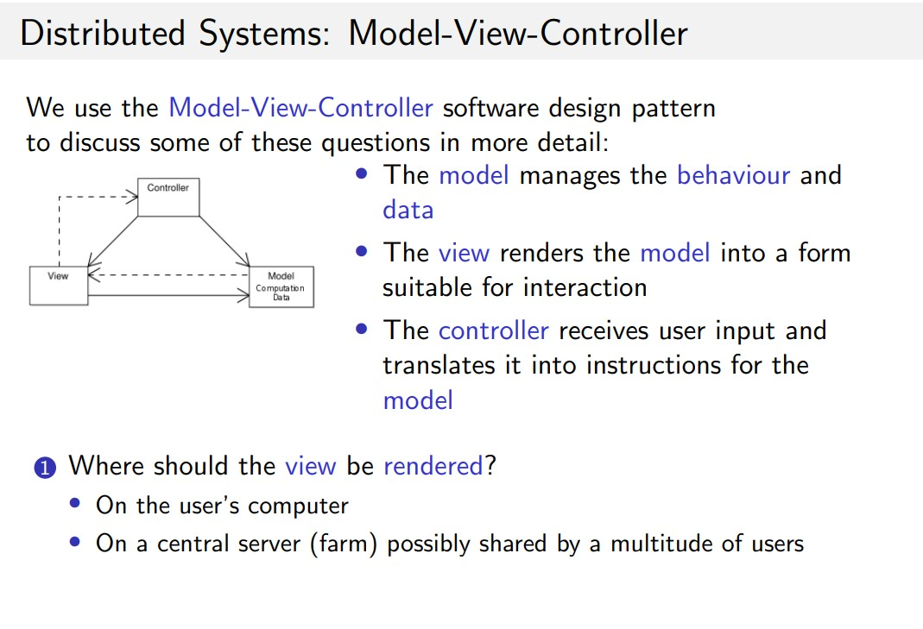
Distributed Systems

Slide 19
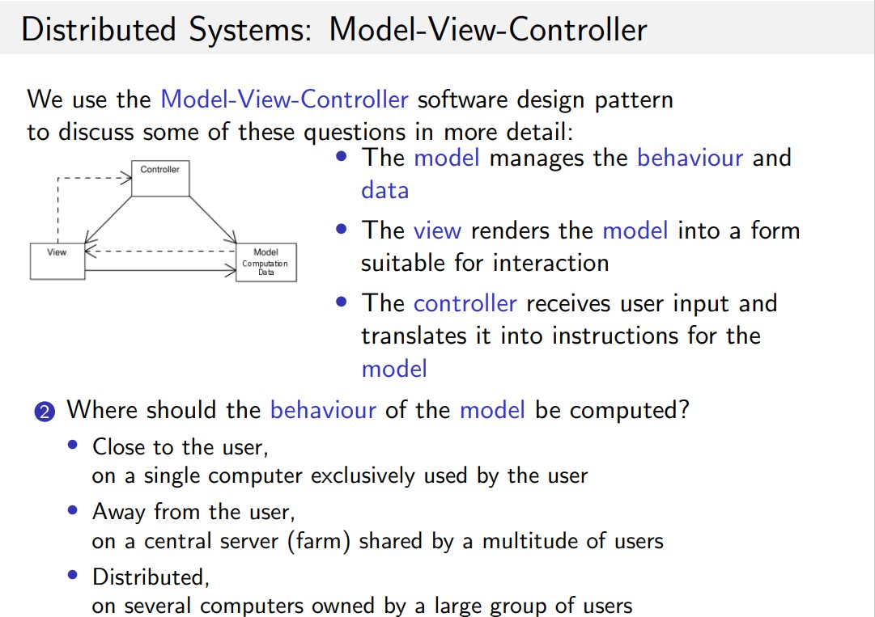
Distributed Systems

Slide 20
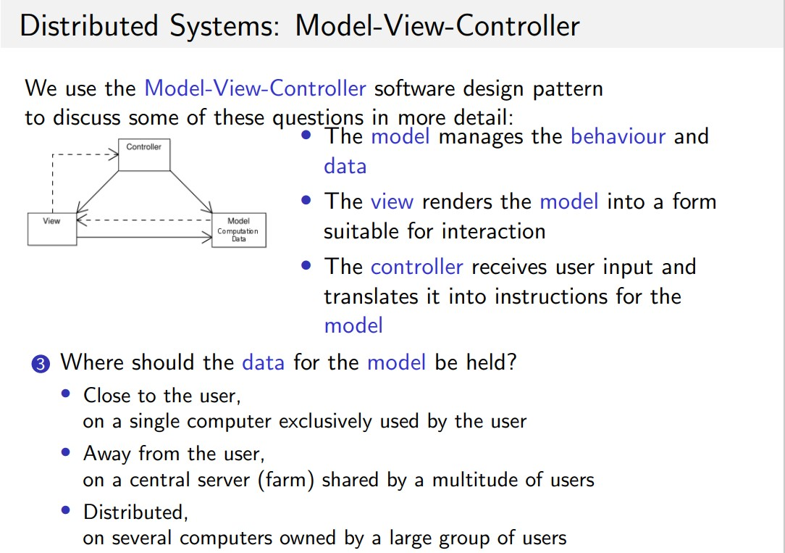
Distributed Systems

Slide 21
MVC Model
Controller
Update
Notify
Update
User Action
Model
View

Slide 22
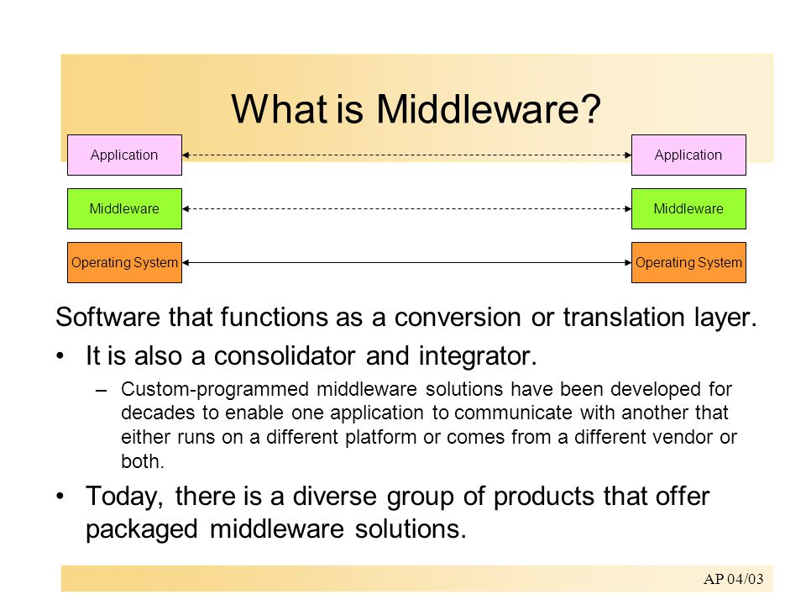
Middleware

Slide 23
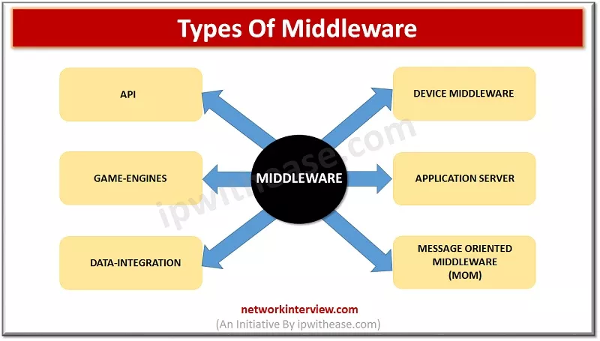
Middleware

Slide 24
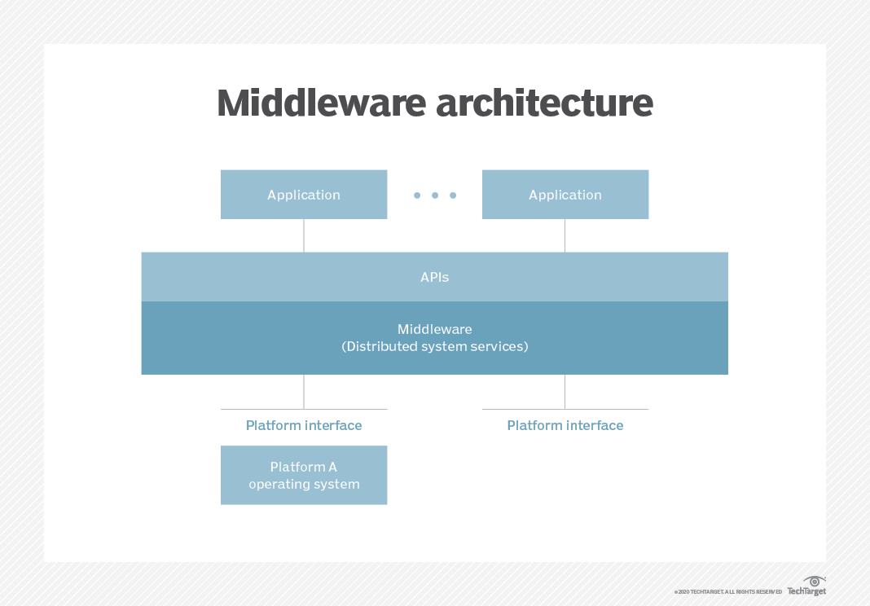
Middleware

Slide 25
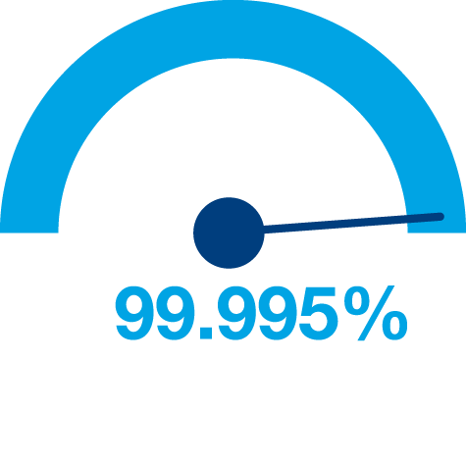
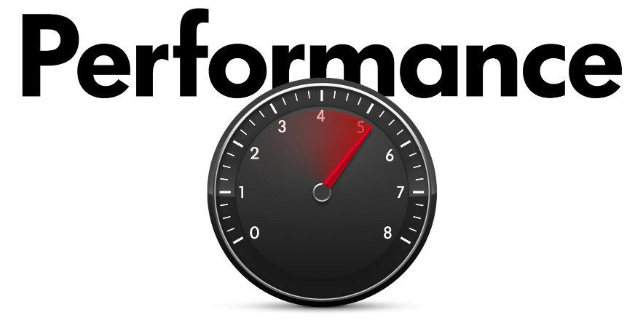
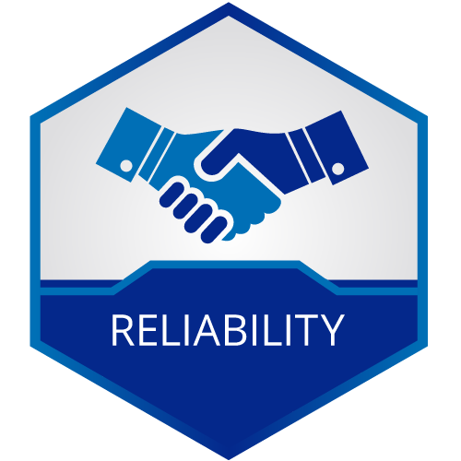
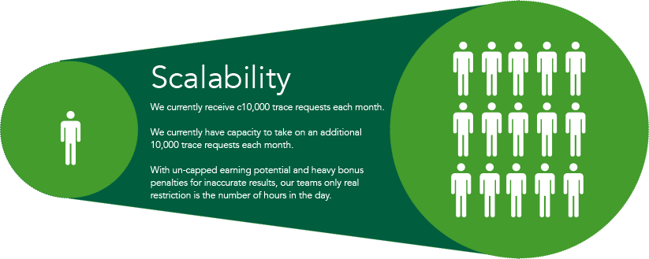

Principles of Web Design
Availability
Performance
Reliability
Scalability
Manageability
Cost
Notes:
Availability: The uptime of a website is absolutely critical to the reputation and functionality of many companies. For some of the larger online retail sites, being unavailable for even minutes can result in thousands or millions of dollars in lost revenue, so designing their systems to be constantly available and resilient to failure is both a fundamental business and a technology requirement. High availability in distributed systems requires the careful consideration of redundancy for key components, rapid recovery in the event of partial system failures, and graceful degradation when problems occur.
Performance: Website performance has become an important consideration for most sites. The speed of a website affects usage and user satisfaction, as well as search engine rankings, a factor that directly correlates to revenue and retention. As a result, creating a system that is optimized for fast responses and low latency is key.
Reliability: A system needs to be reliable, such that a request for data will consistently return the same data. In the event the data changes or is updated, then that same request should return the new data. Users need to know that if something is written to the system, or stored, it will persist and can be relied on to be in place for future retrieval.
Scalability: When it comes to any large distributed system, size is just one aspect of scale that needs to be considered. Just as important is the effort required to increase capacity to handle greater amounts of load, commonly referred to as the scalability of the system. Scalability can refer to many different parameters of the system: how much additional traffic can it handle, how easy is it to add more storage capacity, or even how many more transactions can be processed.
Manageability: Designing a system that is easy to operate is another important consideration. The manageability of the system equates to the scalability of operations: maintenance and updates. Things to consider for manageability are the ease of diagnosing and understanding problems when they occur, ease of making updates or modifications, and how simple the system is to operate. (I.e., does it routinely operate without failure or exceptions?)
Cost: Cost is an important factor. This obviously can include hardware and software costs, but it is also important to consider other facets needed to deploy and maintain the system. The amount of developer time the system takes to build, the amount of operational effort required to run the system, and even the amount of training required should all be considered. Cost is the total cost of ownership.

Slide 26
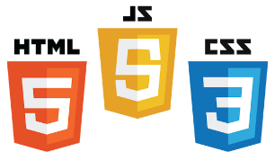
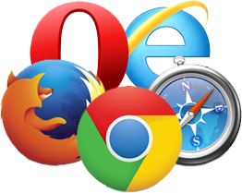
UI (Front End (DOM, Framework))
Request Layer (Web API)
Back End (Database, Logic)
Core Components of Web Applications
Server
Client
API
Front End
Database
Browser
Internet
Logic
JSON
Media Cache
Notes:
Break down into front end and back end

Slide 27
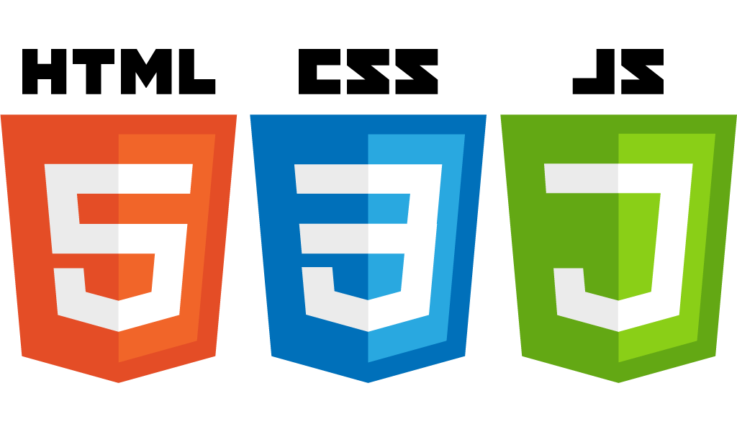
Front End Languages
HTML/CSS
Javascript
Java (applets)
What is the most popular?
Answer: Javascript/HTML/CSS is the only real option for front-end native languages and is basically the standard. But there are many variations on JavaScript that are used.
Notes:
Javascript adoption with ES6, ‘don’t forget about babel’
Node.js:
Swift 2: Apples vision for modern web programming
Go: growing in popularity with startups
TypeScript: Beauty of statically type Javascript (PS: Microsoft Technology)

Slide 28

DOM (Document Object Model)
Document Object Model makes every addressable item in a web application an Object that can be manipulated for color, transparency, position, sound and behaviors.
Every HTML Tag is a DOM object

Slide 29
What is a Framework?
Software Framework designed to reduce overhead in web development
Types of Framework Architectures
  Model-View-Controller (MVC)
  Push vs Pull Based
    Most MVC Frameworks user push-based architecture “action based” (Django, Ruby on Rails, Symfony, Stripes)
    Pull-based or “component based” (Lift, Angular2, React)
  Three Tier Organization
    Client (Usually the browser running HTML/Javascipt/CSS)
    Application (Running the Business Logic)
    Database (Data Storage)
Types of Frameworks
  Server Side: Django, Ruby on Rails
  Client Side: Angular, React, Vue
Notes:
MVC: separated (data model, logic, user interface)
Push-based frameworks use actions that do the required processing, and then "push" the data to the view layer to render the results
component-based: These frameworks start with the view layer, which can then "pull" results from multiple controllers as needed.

Slide 30
That’s All for Today

